Slide 1
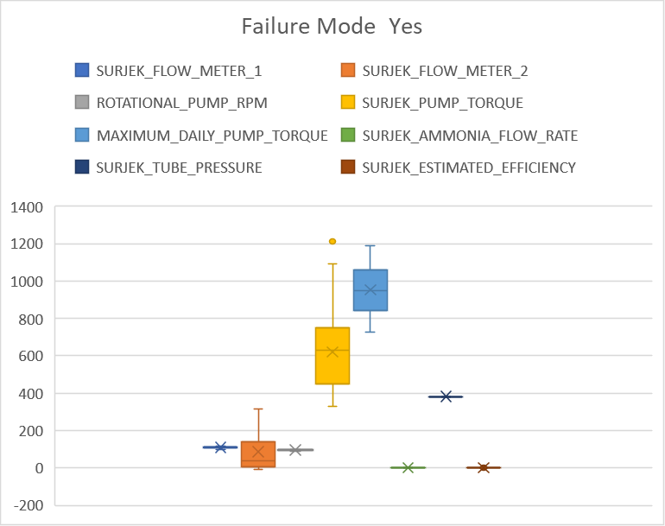
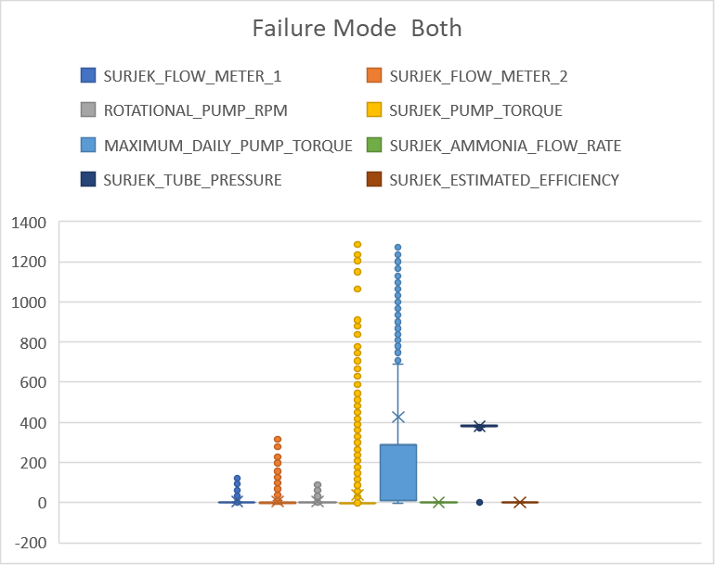
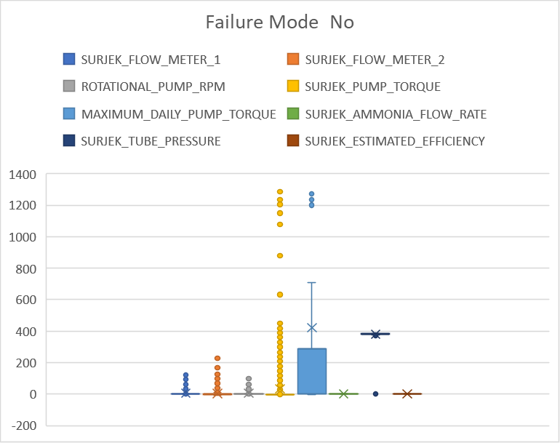
BoxPlots

Slide 2
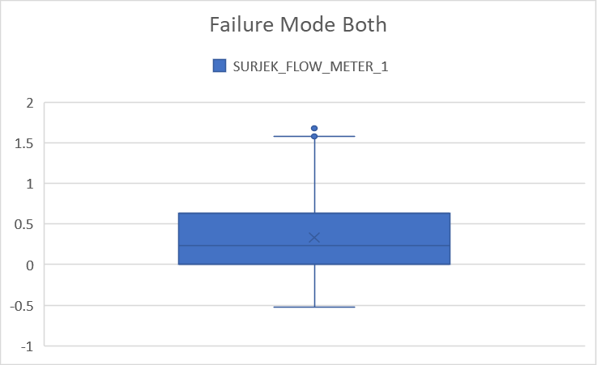
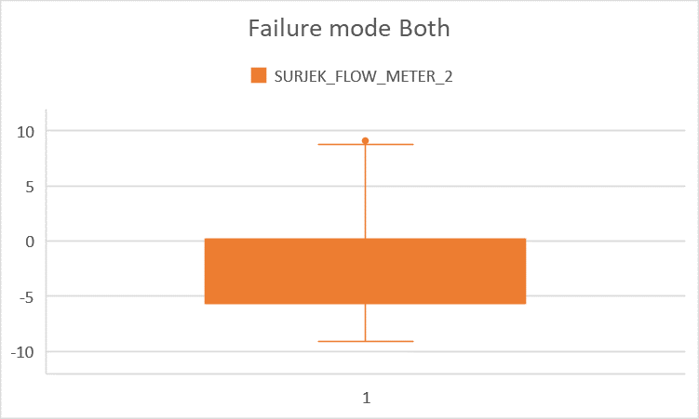
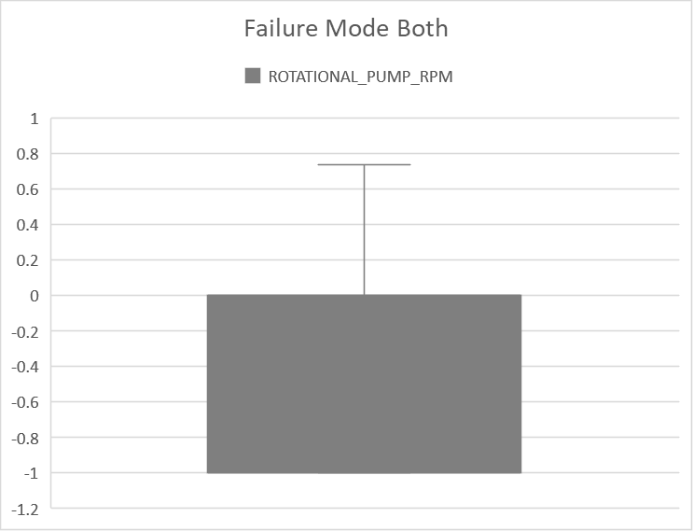
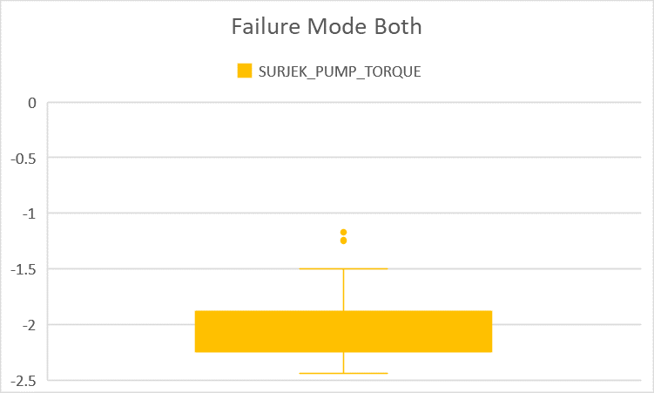
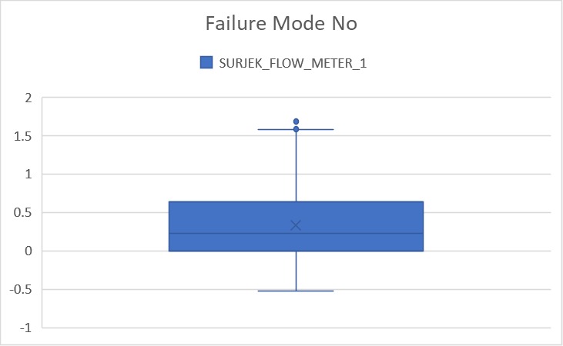



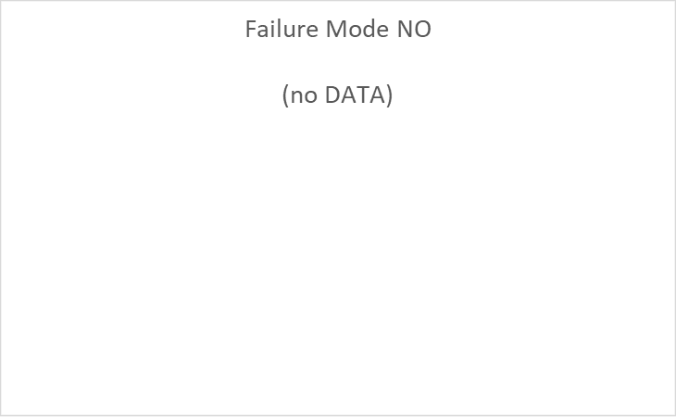
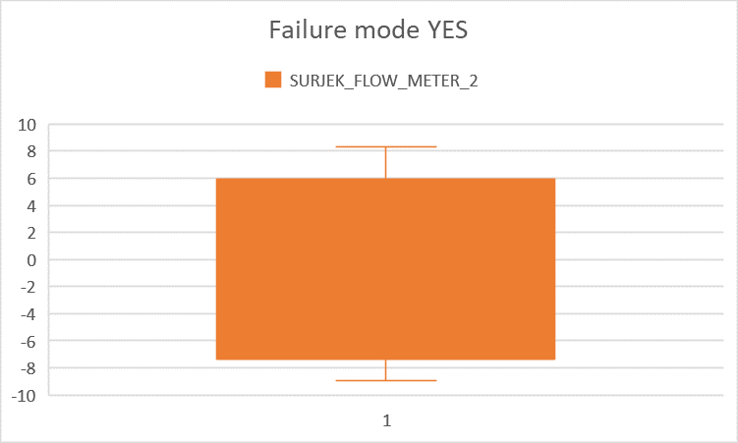
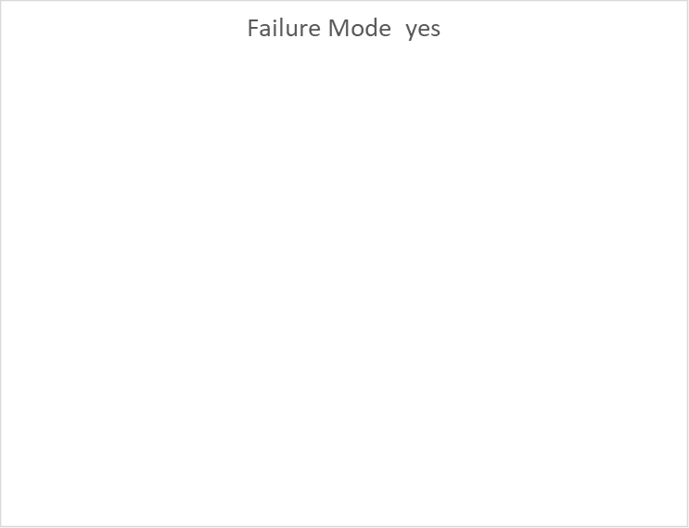
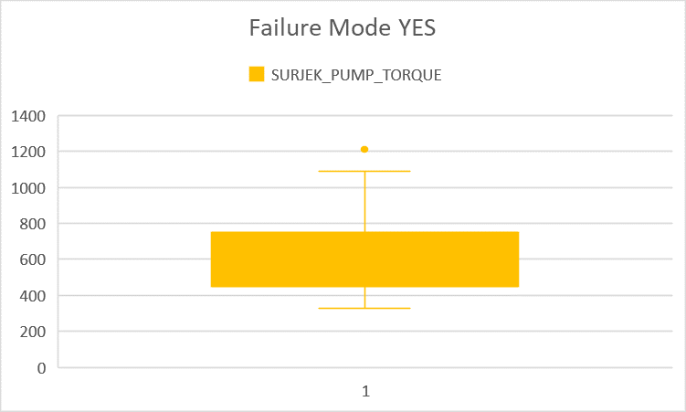
Outerlier Removed Comparison
SURJEK_FLOW_METER_1
SURJEK_FLOW_METER_2
ROTATIONAL_PUMP_RPM
SURJEK_PUMP_TORQUE

Slide 3
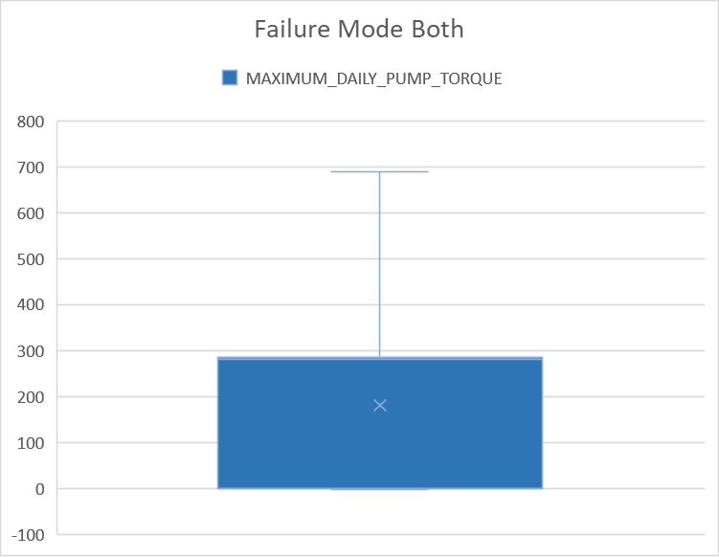
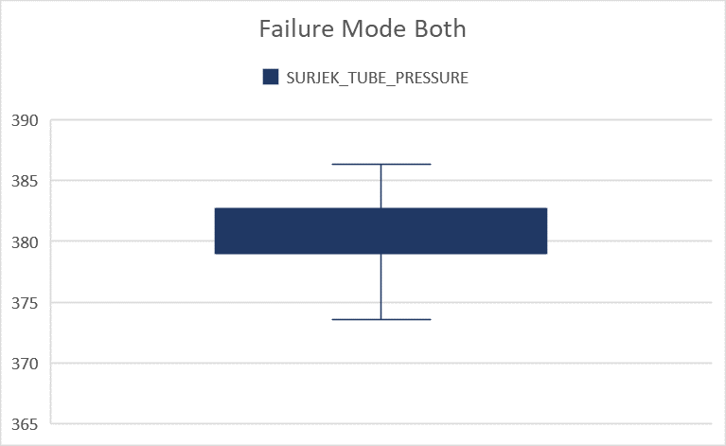
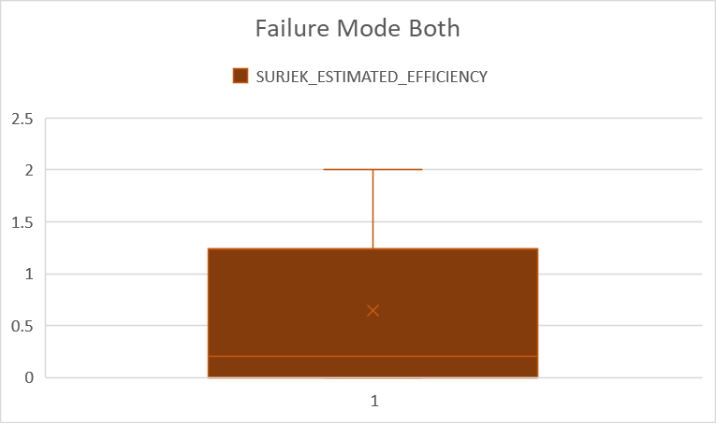



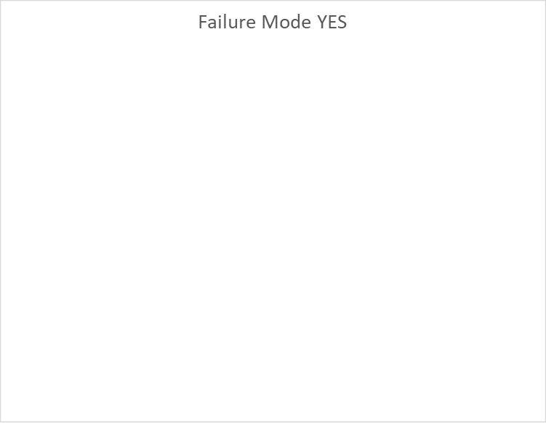
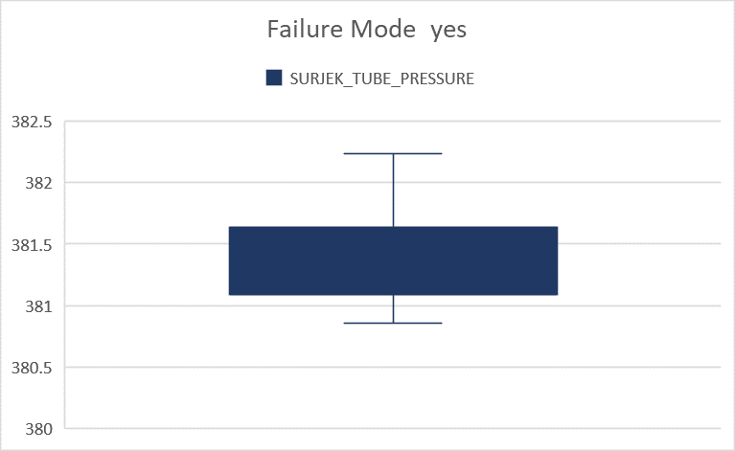
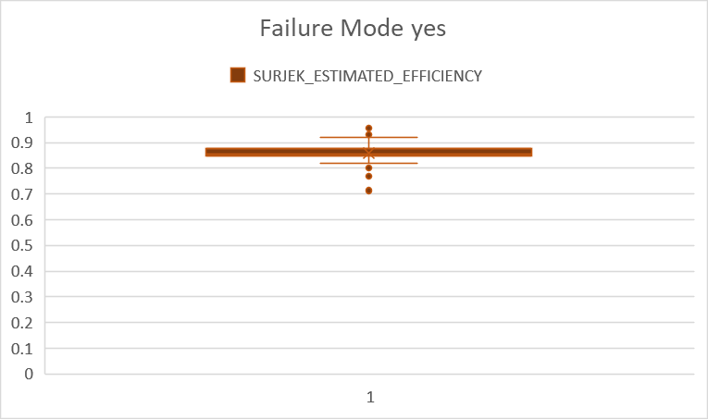
Outerlier Removed Comparison
MAXIMUM_DAILY_PUMP_TORQUE
SURJEK_TUBE_PRESSURE
SURJEK_ESTIMATED_EFFICIENCY

Slide 4
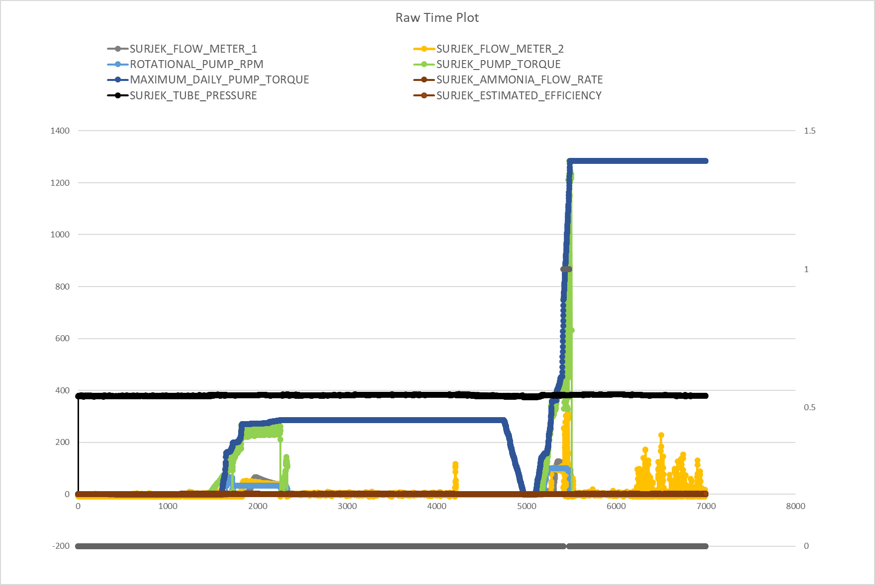

Slide 5
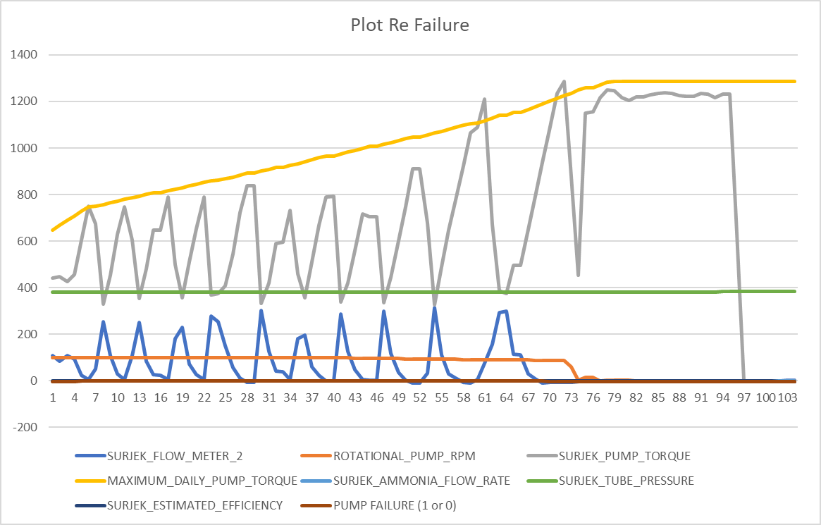

Slide 6
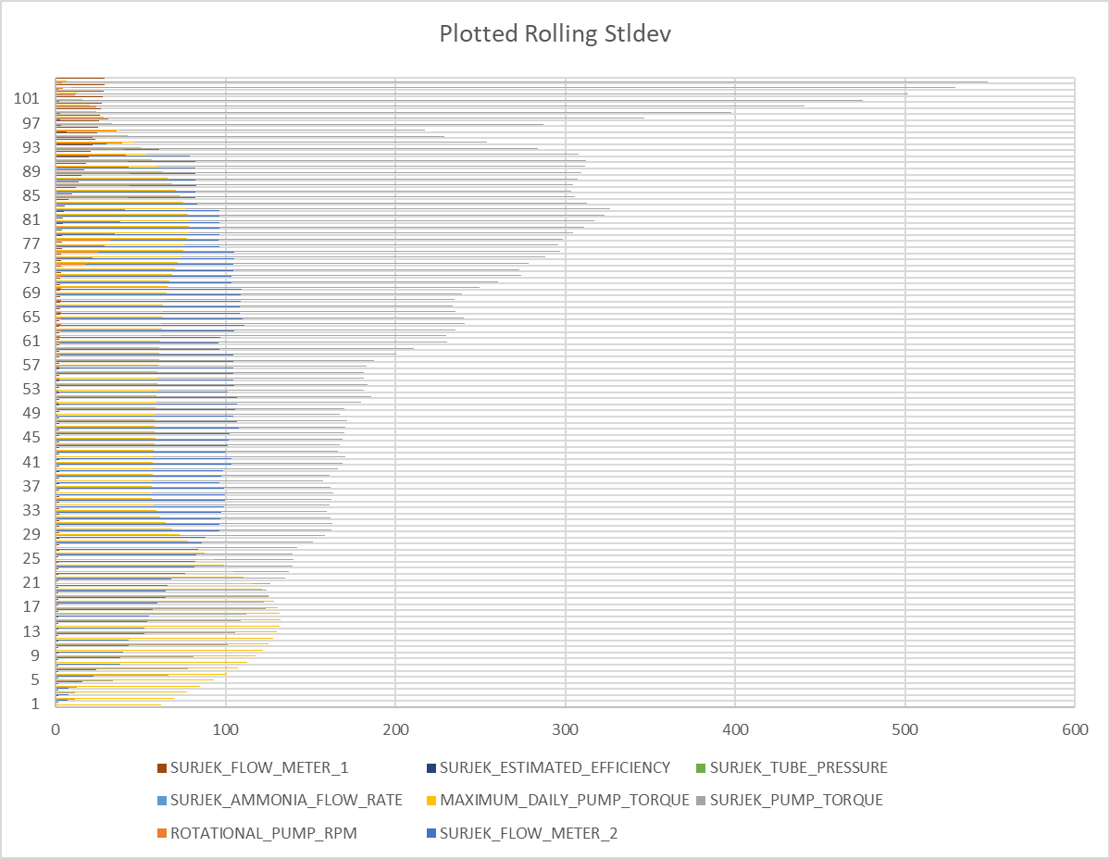

Slide 7
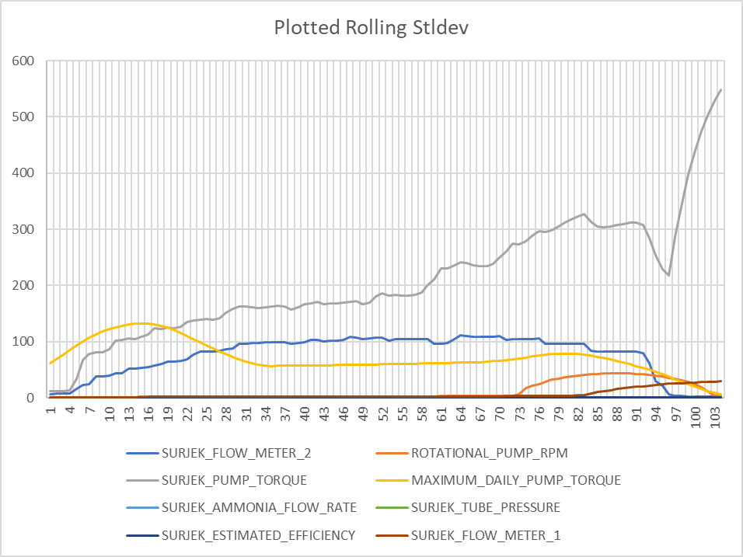

Slide 8
Variables related to pump failure
BoxPlots
Raw Time Plots
SURJEK_FLOW_METER_1
SURJEK_FLOW_METER_2
ROTATIONAL_PUMP_RPM
SURJEK_PUMP_TORQUE
MAXIMUM_DAILY_PUMP_TORQUE
SURJEK_ESTIMATED_EFFICIENCY
SURJEK_FLOW_METER_1
SURJEK_FLOW_METER_2
ROTATIONAL_PUMP_RPM
SURJEK_PUMP_TORQUE
MAXIMUM_DAILY_PUMP_TORQUE
Rolling STDEV Plots
SURJEK_FLOW_METER_2
SURJEK_PUMP_TORQUE

Slide 9
Correlation matrix
 | SURJEK_FLOW_METER_1 | SURJEK_FLOW_METER_2 | ROTATIONAL_PUMP_RPM | SURJEK_PUMP_TORQUE | MAXIMUM_DAILY_PUMP_TORQUE | SURJEK_AMMONIA_FLOW_RATE | SURJEK_TUBE_PRESSURE | SURJEK_ESTIMATED_EFFICIENCY
PUMP FAILURE (1 or 0) | 0.494104004 | 0.326739806 | 0.4173841 | 0.452760536 | 0.107466793 | #DIV/0! | 0.00996646 | 0.027142782
Matrix Analysis Rolling SD
 | SURJEK_FLOW_METER_1 | SURJEK_FLOW_METER_2 | ROTATIONAL_PUMP_RPM | SURJEK_PUMP_TORQUE | MAXIMUM_DAILY_PUMP_TORQUE | SURJEK_AMMONIA_FLOW_RATE | SURJEK_TUBE_PRESSURE | SURJEK_ESTIMATED_EFFICIENCY
PUMP FAILURE (1 or 0) | 0.05596 | 0.581603 | 0.006766 | 0.368838 | 0.71387 | #DIV/0! | -0.0181 | -0.08282

Slide 10
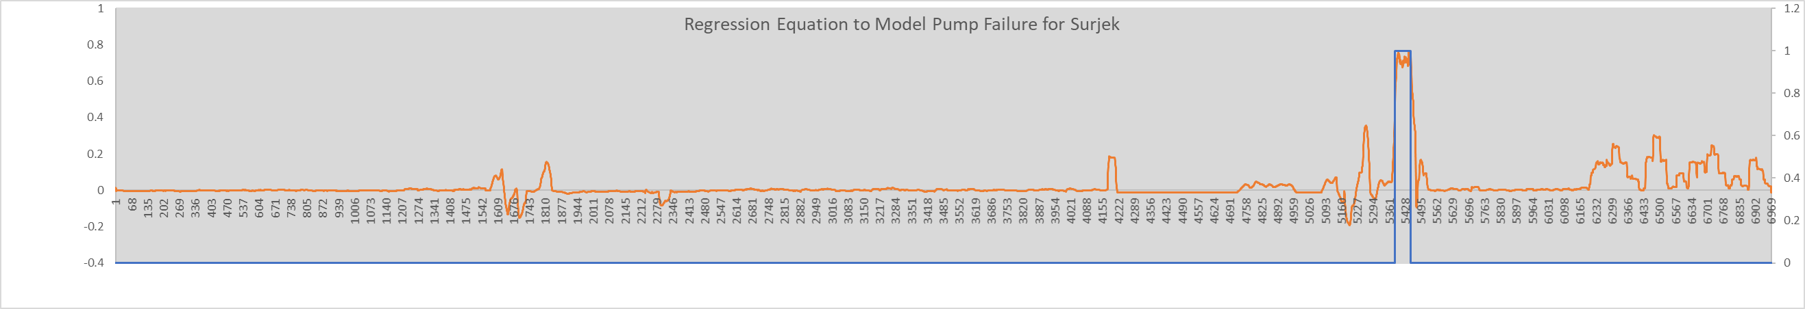
Regression Equation
Regression Statistics
Multiple R | 0.839495868
R Square | 0.704753313
Adjusted R Square | 0.704321902
Standard Error | 0.058852916
Observations | 5484
 | Coefficients | Standard Error | t Stat | P-value | Lower 95% | Upper 95% | Lower 95.0% | Upper 95.0%
Intercept | -0.01242589 | 0.001134772 | -10.95012411 | 1.28111E-27 | -0.014650493 | -0.010201286 | -0.014650493 | -0.010201286
SURJEK_FLOW_METER_1 | -0.001339183 | 0.00034951 | -3.831597538 | 0.000128739 | -0.002024362 | -0.000654004 | -0.002024362 | -0.000654004
SURJEK_FLOW_METER_2 | 0.004853287 | 0.000120391 | 40.31268599 | 0 | 0.004617273 | 0.005089301 | 0.004617273 | 0.005089301
ROTATIONAL_PUMP_RPM | -0.006787063 | 0.000246907 | -27.48834042 | 6.1603E-156 | -0.007271099 | -0.006303027 | -0.007271099 | -0.006303027
SURJEK_PUMP_TORQUE | 0.000166164 | 4.94808E-05 | 3.358148418 | 0.00079002 | 6.91618E-05 | 0.000263166 | 6.91618E-05 | 0.000263166
MAXIMUM_DAILY_PUMP_TORQUE | 0.003485786 | 0.000105034 | 33.18721834 | 3.2039E-220 | 0.003279877 | 0.003691694 | 0.003279877 | 0.003691694
SURJEK_AMMONIA_FLOW_RATE | 0 | 0 | 65535 | #NUM! | 0 | 0 | 0 | 0
SURJEK_TUBE_PRESSURE | 0.000179806 | 0.000487749 | 0.368645038 | #NUM! | -0.000776375 | 0.001135988 | -0.000776375 | 0.001135988
SURJEK_ESTIMATED_EFFICIENCY | 0.005117018 | 0.002858914 | 1.789846574 | 0.073533824 | -0.00048759 | 0.010721625 | -0.00048759 | 0.010721625

